Slide 1

STUDENTS HABIT INSIGHTS
A data science project based on students behaviour and their habit. How this things affecting their academic and personal life. I am Pradip Pawar who done this job.

Slide 2
About dataset
This is a big dataset containing 16 column and 1000 rows.
In the ‘parental_education_level’ column there are 91 rows have missing values and I am considering them as an uneducated parents.
Using this data we found the students habits and their behaviours as well as we also predict their family background, (Financially, educationally etc.).

Slide 3
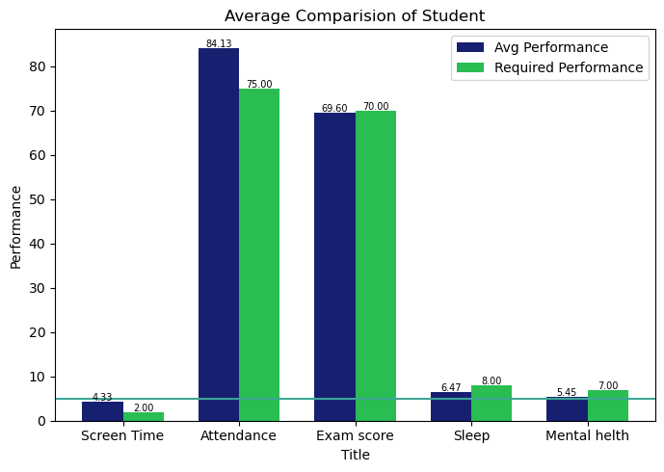
Average performance of the student
Student personal life
The average screen time of a student is 4.33 hrs per day.
On an average a student sleep’s for 6.5 -7 hrs per day.
The mental health of student is highly disturbed 5.45 – 6 below the normal level.
Students academic life
Attendance of a student is more that mandatory 75%.
They are performing well in the exams scoring good marks.

Slide 4
Key insights
Majority of students personal life is affected. It can be by:
Higher screen time
Less sleep
Down mental health
Based on the unfiltered data and the average comparison between the different factors, we can say;
While their personal life is disturbed but still they performing well in their academics. Due to:
Pressure
Awareness

Slide 5
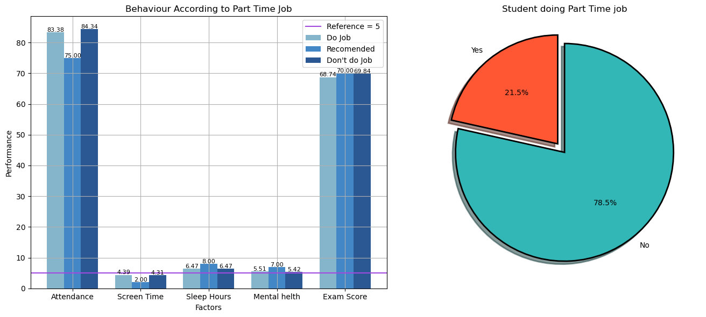
Behaviour according part time job
In this data we can observe out of 1000 student only 21.5% students do part time job. Which indicated that
Majority of students are financially well stable
But does job really affects students life, personally or academically?

Slide 6
Behaviour according part time job
Does job affects students habits?
In this graph we can see the student who do job and who do not they both show very similar behaviours.
Attendance same
Screen time same
Mental health same
Sleep hours same
Exam score same
So no. Job doesn't affect students life.

Slide 7
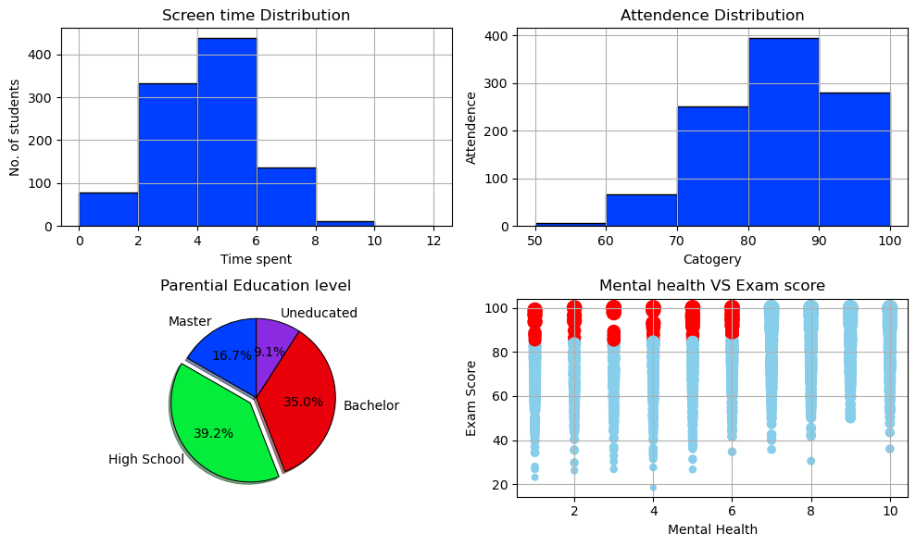
Behaviour according to parental education level
How much parents are educated?
16.7% parents are highly educated at masters level
35% parents are educated at Bachelor level
39.2% parents are only completed their High School.
Where 9.1% people are uneducated.
Basically higher education = higher attention on child?

Slide 8
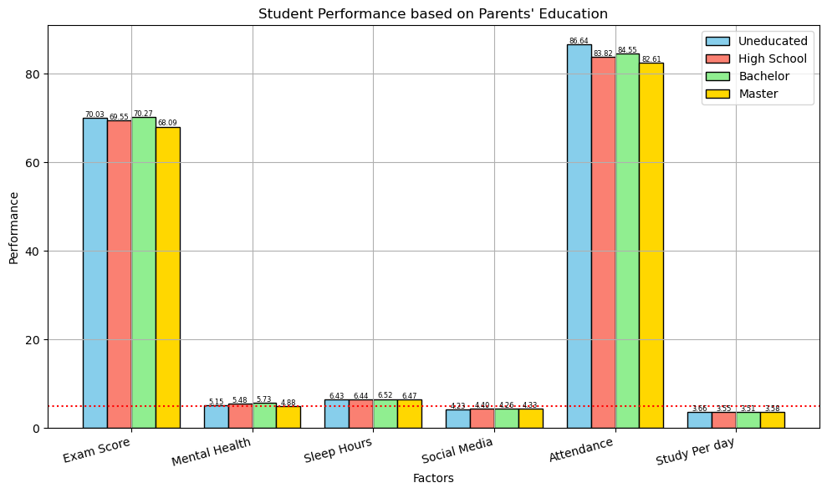
Behaviour according to parental education level
Higher education = Higher attention on child?
According to this data No.
Each and every thing in a student is same with some minor changes. No matter how parents are educated students build their habits. This can be a Generation Gap.

Slide 9
Habits that student build
Distribution of screen time
In this graph we can see screen time of student
The student who spend 8 – 10 hrs a day on screen are only 10 – 20
And the student who spend less that 2 hrs are around 80.
But the massive audience spend the most of time on screen around 2 – 8 hrs a day are more than 450.

Slide 10
Habits that student build
Distribution of Attendance
This graph shows the attendance of their school or college
Almost 80% student filling the criteria of attendance
Nearly 400 student attendance is 80 – 90%
Around 280 students attendance is 90 – 100%
So may be they are mentally fit!

Slide 11
Habits that student build
Mental health VS Exam score
This graph shows the students mental health and how its performance in that state.
X – axes shows the mental health should be 7+
Y – axes shows the Exam score.
But most of the students have lesser than 7 mental health score are still scoring 85% +

Slide 12
Habits that student build
Students shows same behaviour, their parents education doesn’t matters
Student spend their 4 – 8 hrs a day on social media and Netflix
Students attendance is not affected
Majority of students mental health is below than 7. average it is 5.45
Students personal life not affecting their academic life
Some student whose mental health is below 7 are still scoring 85+ % in exams

Slide 13
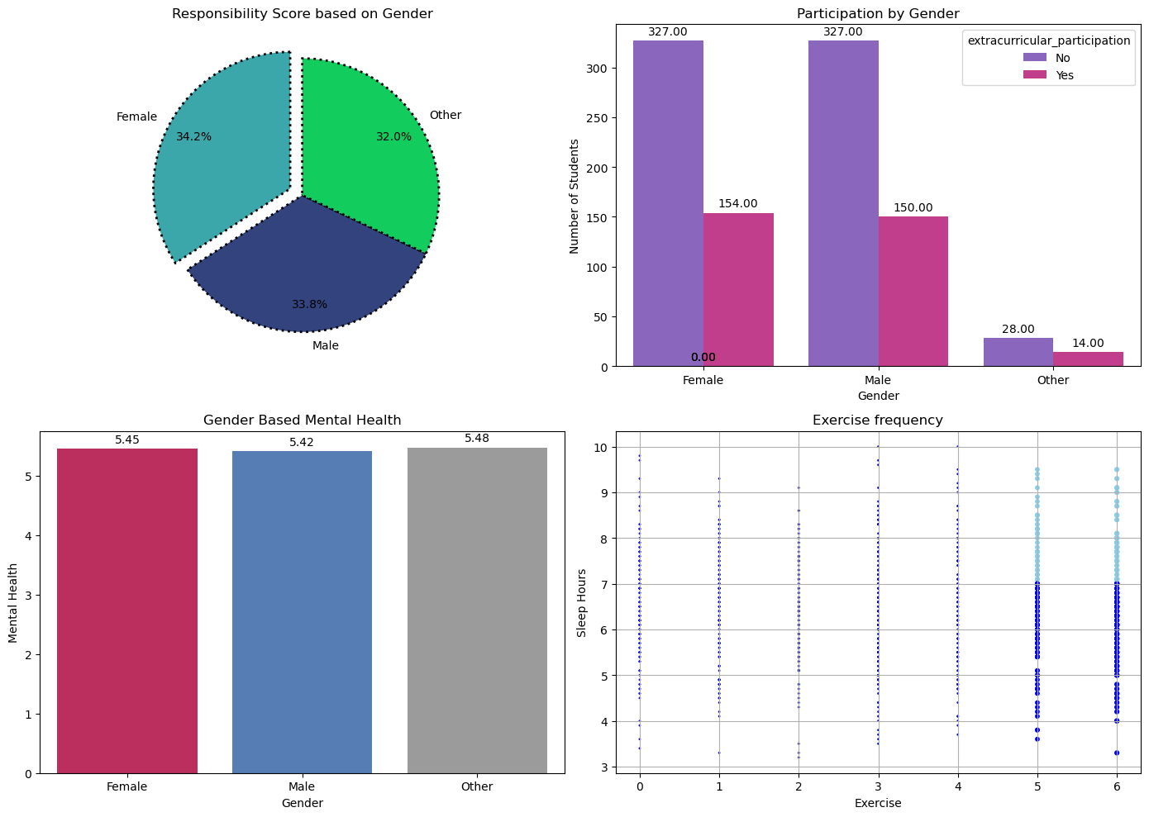
Patterns according to gender
Responsible gender
Based on this chart we can predict which gender is more responsible using a formula
[Exam Score/Screen Time]
34.2% Female
33.8% Male
32.0% Other
So we can say that females are slightly more responsible but this gap is very small

Slide 14
Patterns according to gender
Extra curricular participation
This graph shows the gender based extra curricular participation
Both male are female are same in participation yes and no
Others group is differs form male and female

Slide 15
Patterns according to gender
Mental health score
In mental health score both genders are at same level without a slight difference.

Slide 16
Conclusion
Parents should pay attention
Focus on personal life as well
Reduce the screen time
Participate in activates
Focus on personal life

